Slide 1

Microsoft PowerApps and Flow
Crash course

Slide 2
Lesson 1.1 Quick Basics – Power Apps

Slide 3
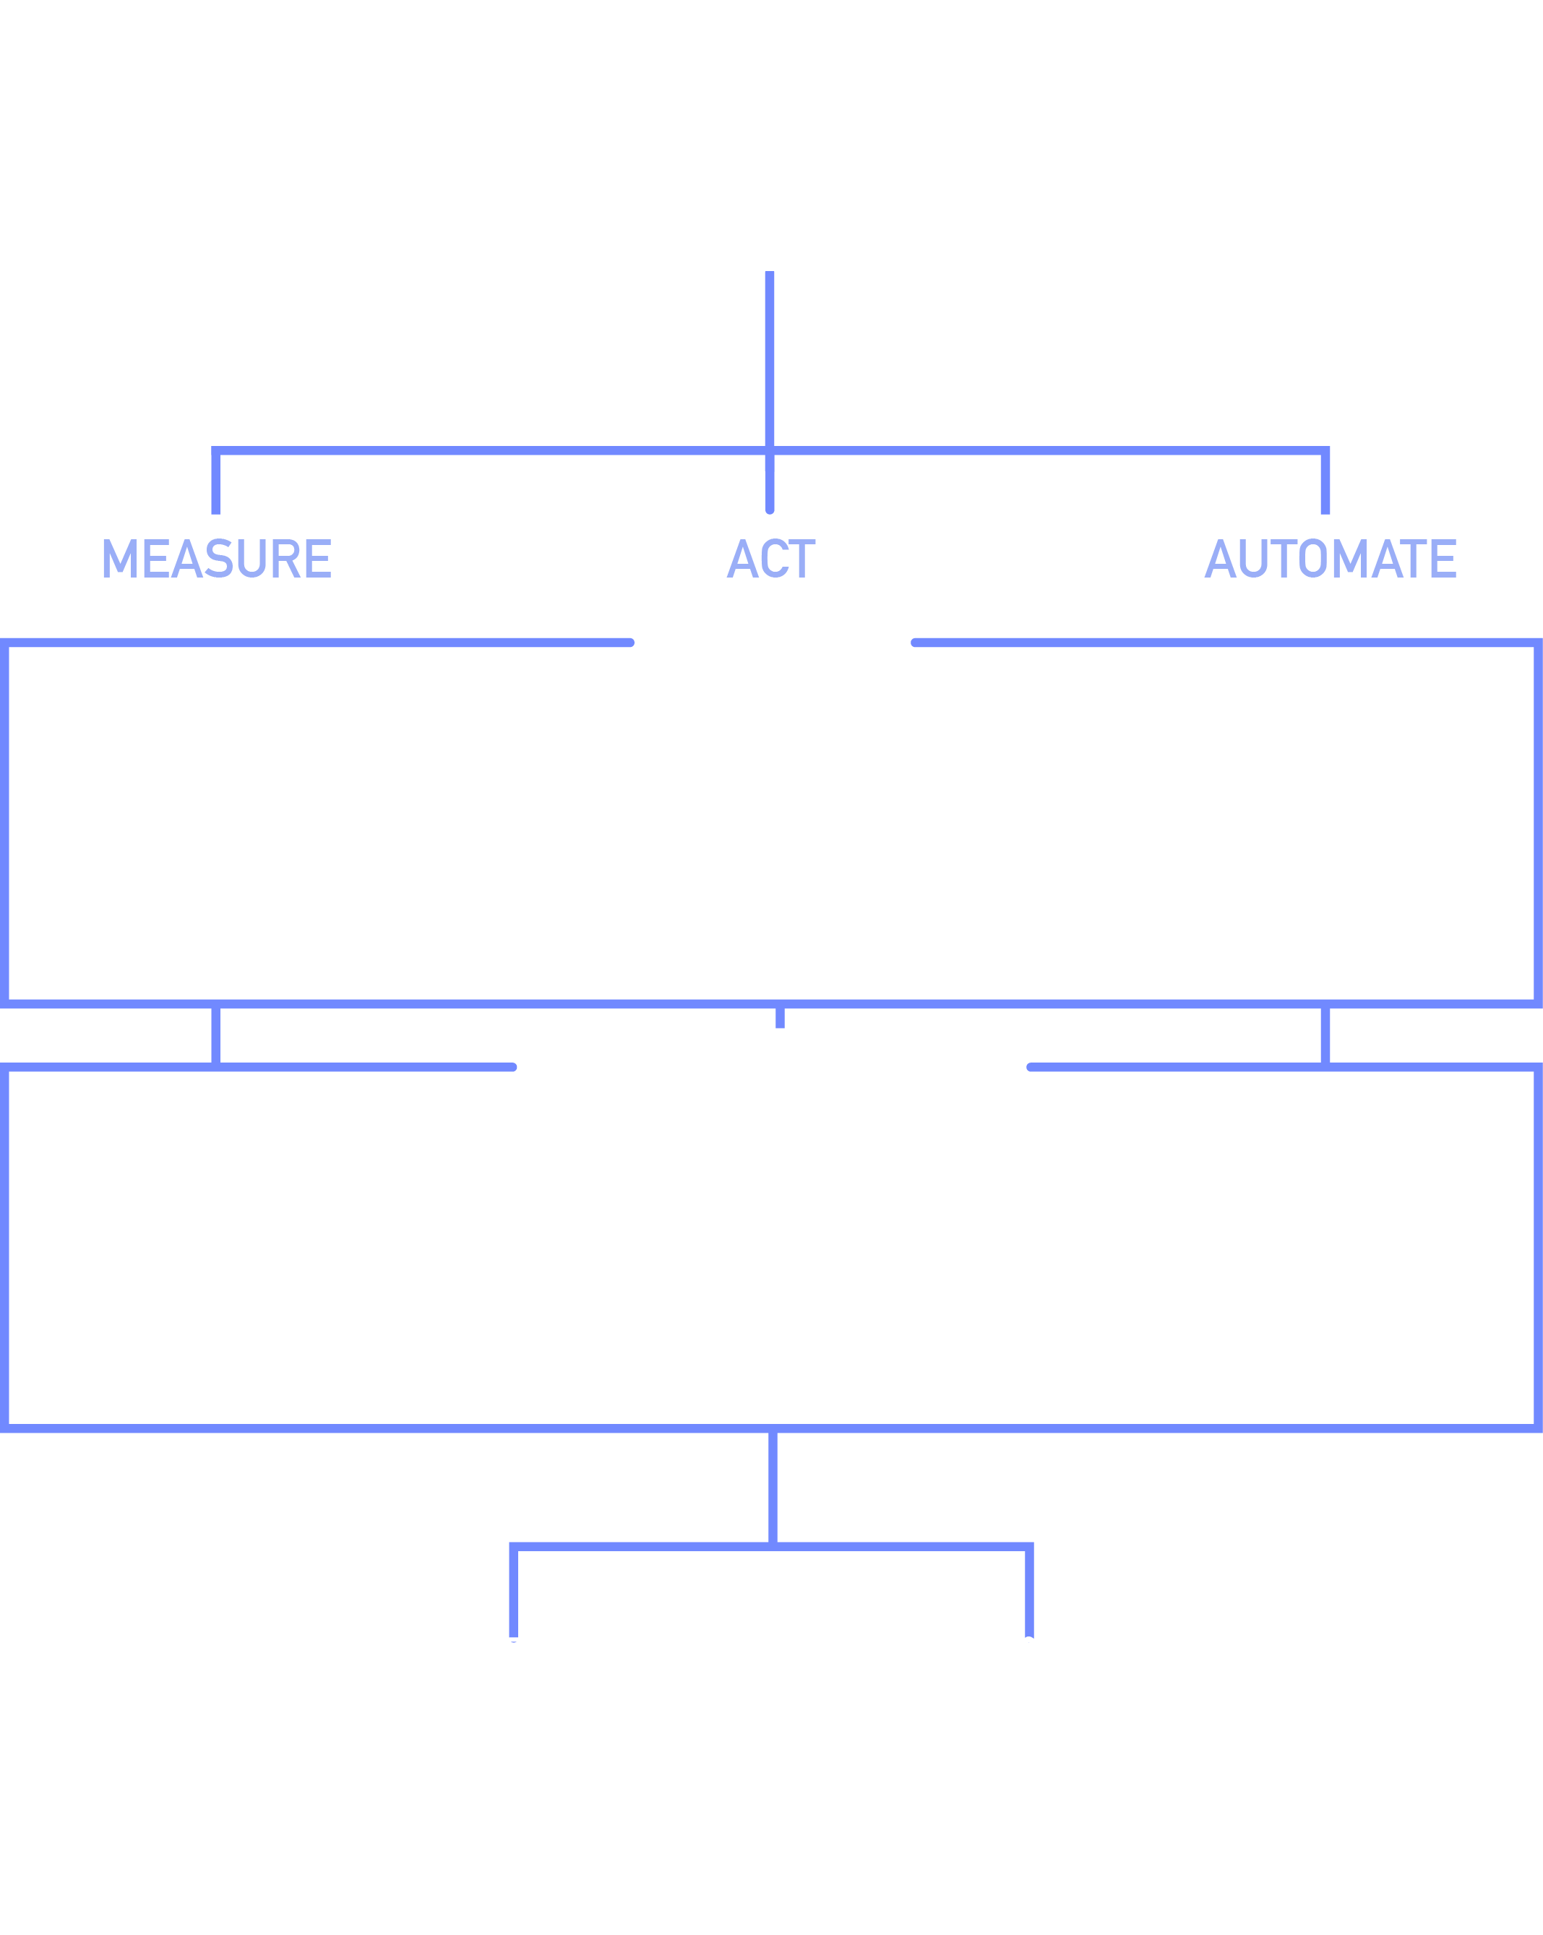
Business Application Platform Innovation
Innovate faster
Power users build “no code” solutions
Create mobile business apps with clicks, ‘not code’
Enterprise Developers and IT pros
Extend capabilities for power users
Rich platform services with power of Azure
App Services, Service Fabric, Azure Functions, Logic Apps, API Management, BizTalk…Turn your data into apps
Connects to everywhere, securely
It works on all devices, Easy to deploy and test
https://powerusers.microsoft.com/ https://businessplatform.microsoft.com/en-us/

Slide 4
Businesses need to deliver apps in a way that stays extensible, connected, secure and fast
ACT
PowerApps
AUTOMATE
Flow
Connectors to Data and APIs

Slide 5



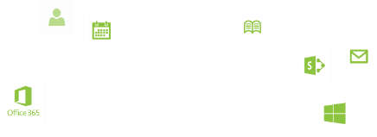
With PowerApps and Microsoft Flow, building powerful and rich visual apps with business process automation isn't just for developers anymore.
Using a simple visual designer, you can create your own app that integrates the systems and data you use every day, without writing a single line of code.
Notes:
Today Excel, Access and Infopath are among the most popular application platform for power users to build macro based automation. However, it does not scale in cloud and do not run on mobile devices.
The power user community needs new set of tools to help them build applications that run in the cloud and can be consumed by mobile devices.
PowerApps and Flow are two such tools for building rich visual apps without any code. Both these tools now integrate natively within SharePoint and OneDrive and can be leveraged to customize data entry forms, integrate data from other sources and build workflows.

Slide 6
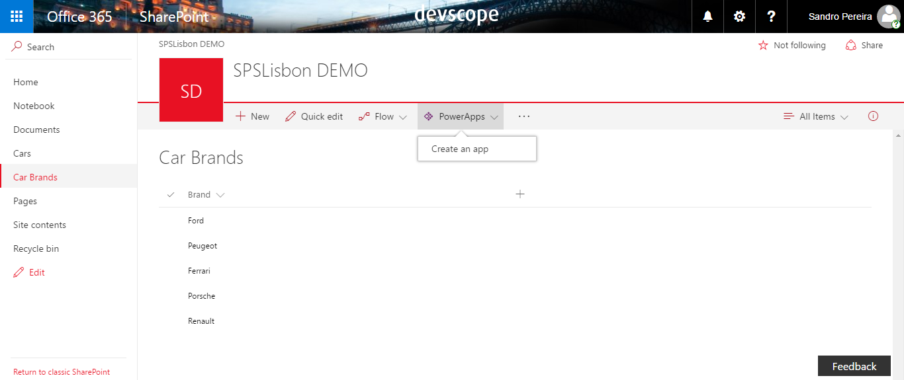
PowerApps and SharePoint
Create new PowerApps from your SharePoint Online list in the browser
Simple CRUD operations (Create, Read, Update, Delete)
Full read/write support for all Sharepoint list data types including Person or Group, Managed Metadata, Lookup, and Multi-select Choice
Support for document libraries
Access on premise using Gateways
https://powerapps.microsoft.com/en-us/blog/powerapps-and-sharepoint
https://powerapps.microsoft.com/en-us/blog/connect-to-your-on-premises-data-sources-using-on-premises-data-gateway-from-powerapps/

Slide 7
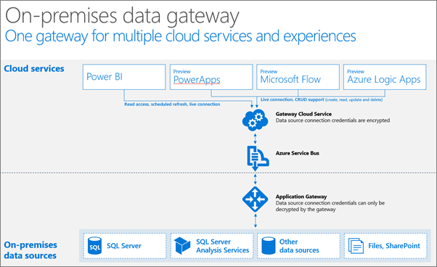
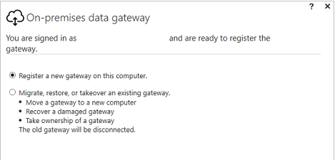
On-Premises Data Gateway
Supports…
SharePoint 2016
SQL Server 2016
Machine should always be accessible
Can’t install on a domain controller
Same technology used by Power BI, PowerApps, and MS Flow

Slide 8
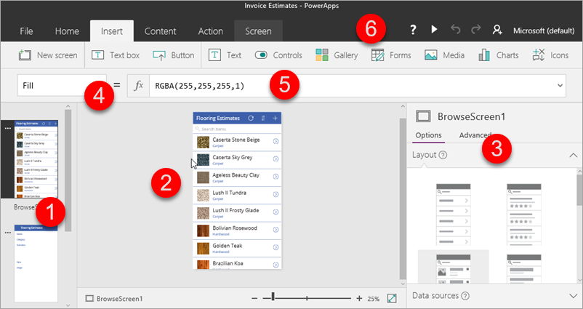
Basic concepts

Slide 9
Basic concepts
1 - Screens – allows to pick te screen we want to handle at this moment.
2 - Screen/Canvas editor – fire zone. Where all the magic happens.
3 - Properties – sizes, links, positions, datasources and types, etc.
4 - Actions – for controls / screens.
5 – Formula bar (Excel style) – where the dark magic is. This is where we customize our actions or properties.
6 - Controls – where we can choose the various types of controls and add them to the screen.

Slide 10
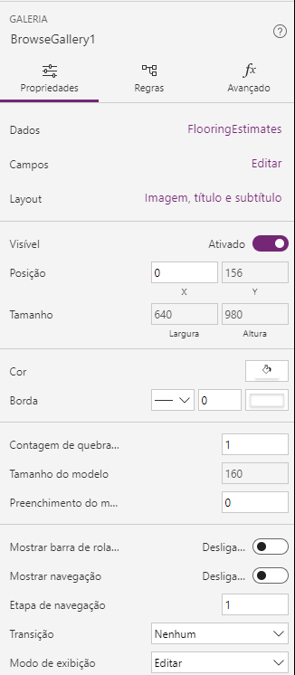
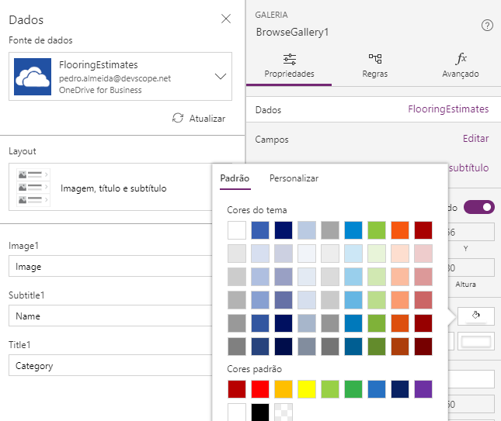
Basic concepts- Properties
Notes:
Nas propriedades podemos definir todos os aspetos dos nossos controlos, screens e algumas ações. Na seção "Avançado" podemos ir ainda mais fundo e entrar na parte de definição de "pseudo-código".
Pseudocódigo é uma forma genérica de escrever um algoritmo, utilizando uma linguagem simples (nativa a quem o escreve, de forma a ser entendida por qualquer pessoa) sem necessidade de conhecer a sintaxe de nenhuma linguagem de programação.

Slide 11
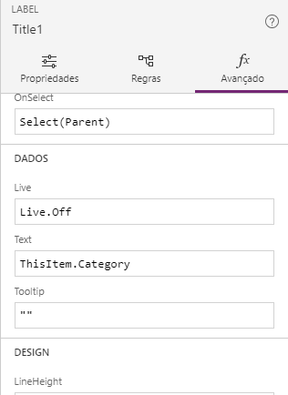
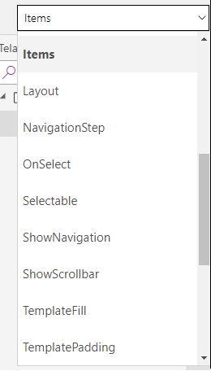
Basic concepts – Actions
Notes:
Cada controlo tem um conjunto de ações comuns e um conjunto específico, devido a serem de tipos diferentes.
Nesta dropdown, podemos ver as ações disponíveis para o controlo selecionado e ver o código que está a correr.
As ações são relativamente fáceis de identificar, porque têm o nome user friendly. Apesar de serem em inglês, conseguimos deduzir facilmente o que afeta.
Ex: Fill - preencher. OnVisible - quando o screen fica visível. OnSelect - na seleção do controlo. Etc.
Estas ações são também visíveis nas propriedades.

Slide 12
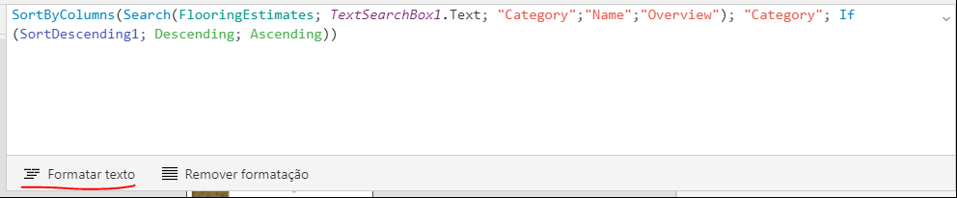
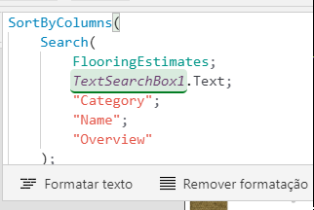
Basic concepts - Formulas
Notes:
Aqui fazemos o nosso código e transformamos o nosso pensamento em palavras para a aplicação executar.
Temos que pegar na ideia que queremos para a ação e converter naquela linguagem simples da app.
P.e., Se a minha fonte de dados estiver vazia, mostro o default do pai, se não mostro o primeiro item da fonte.
If( IsEmpty(Source); Parent.Default; First(Source))
É extremamente importante fecharmos corretamente os parêntesis, senão a ação que estamos a configurar não vai executar.
Quando expandimos a drop de código, é visível um botão para identar o código. Se houver algum erro, a identação não vai ocorrer. Isto dá-nos uma pista para que algo está errado. Além disso, a linha que aparenta estar errada estará com um sublinhado vermelho, com a razão de erro em tooltip.

Slide 13
Basic concepts- Formulas
Notes:
Aqui fazemos o nosso código e transformamos o nosso pensamento em palavras para a aplicação executar.
Temos que pegar na ideia que queremos para a ação e converter naquela linguagem simples da app.
P.e., Se a minha fonte de dados estiver vazia, mostro o default do pai, se não mostro o primeiro item da fonte.
If( IsEmpty(Source); Parent.Default; First(Source))
É extremamente importante fecharmos corretamente os parêntesis, senão a ação que estamos a configurar não vai executar.
Quando expandimos a drop de código, é visível um botão para identar o código. Se houver algum erro, a identação não vai ocorrer. Isto dá-nos uma pista para que algo está errado. Além disso, a linha que aparenta estar errada estará com um sublinhado vermelho, com a razão de erro em tooltip.

Slide 14
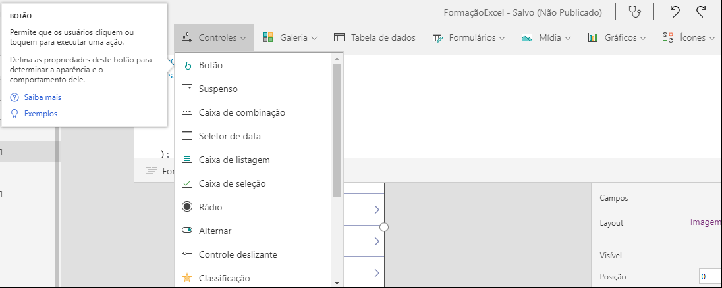
Basic concepts - Controls
Notes:
O conjunto de controlos que podemos escolher é limitado, mas suficiente para 90% dos requisitos das intenções de aplicação.
Quando selecionamos um controlo, este é colocado no container mais elevado ou no selecionado. p.e. Se estiver dentro de uma galeria e já existir um controlo de imagem, o PA pode não permitir que seja inserido outro e adiciona no container geral. Se quisermos substituir o original, temos que o apagar primeiro (depois de desbloquear a edição) e depois adicionar o novo controlo.
Isto pode ser um pouco difícil de entender e de lembrar, mas é uma feature de segurança para impedir que haja duplicidade de controlos e garantir a fluidez da aplicação por toda a sua extensão.

Slide 15
Hands-on Lab Excel integration
Powerapps design is to be logical and imperative. In order to build our action flows, we must think in what we want to do. With this in mind, we translate our words into “pseudo-code”, thus building our flow.
Ex: “I want to delete the item when I click the button.”

Slide 16
Lesson 1.2 Quick Basics – Flow

Slide 17
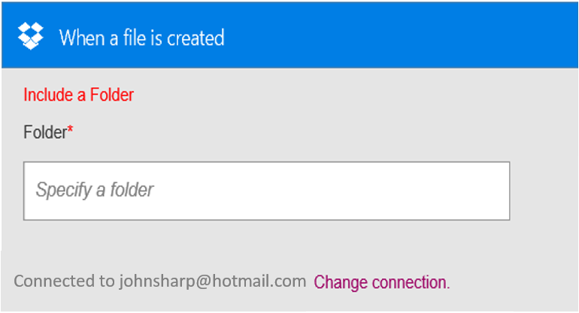
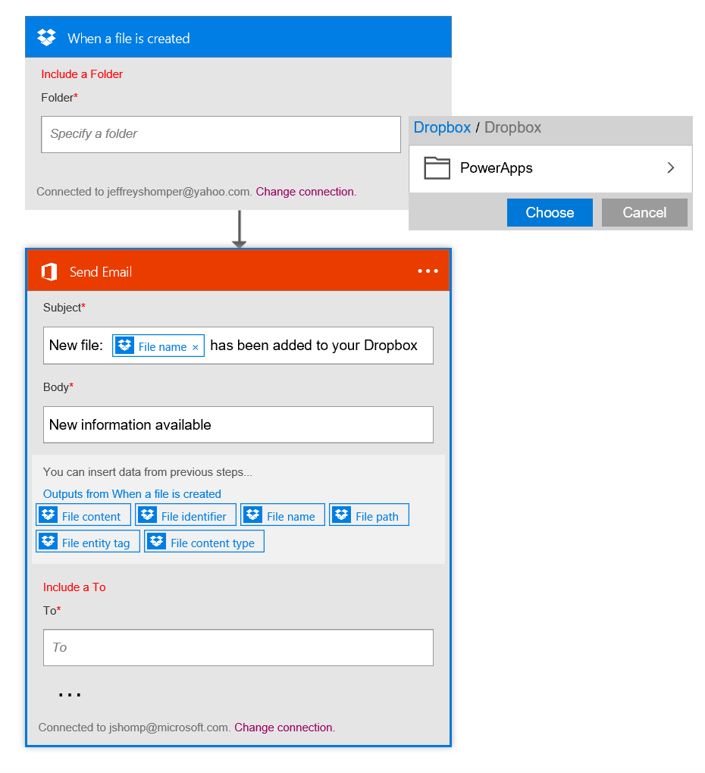
What makes up a flow?
Trigger – the event that kicks off the flow:
manually
on a schedule
on an event in the cloud
Actions – what the flow does
Can use data from the trigger
Now is integrated with Office365

Slide 18
Trigger
Outputs:
File name
Size
File content
Flowing data
Action 1
A binary field would see:
Data ‘flows’ from each step and is available for all later steps
Use Add Dynamic Content to select outputs from previous steps
Certain outputs show up based on the types of the inputs and outputs
File name
Size
File content
Outputs:
Title
Count
Action 2
A string field would see:
A number field would only see:
File name
Size
File content
Count
Title
Size
Count

Slide 19























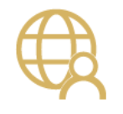




Click-to-code for integrating the systems you’re already using… even custom APIs.
New services being added every week!
https://flow.microsoft.com/manage/connections/available
Notes:
Get a whole bunch of connectors OOTB to common SaaS Services, from O365 (Outlook, OneDrive) to collaborative svcs (Slack) to CRM svcs (Salesforce, Dynamics CRM)
Can support connections to custom APIs (Swagger end point definition)
URL for full list of connectors

Slide 20
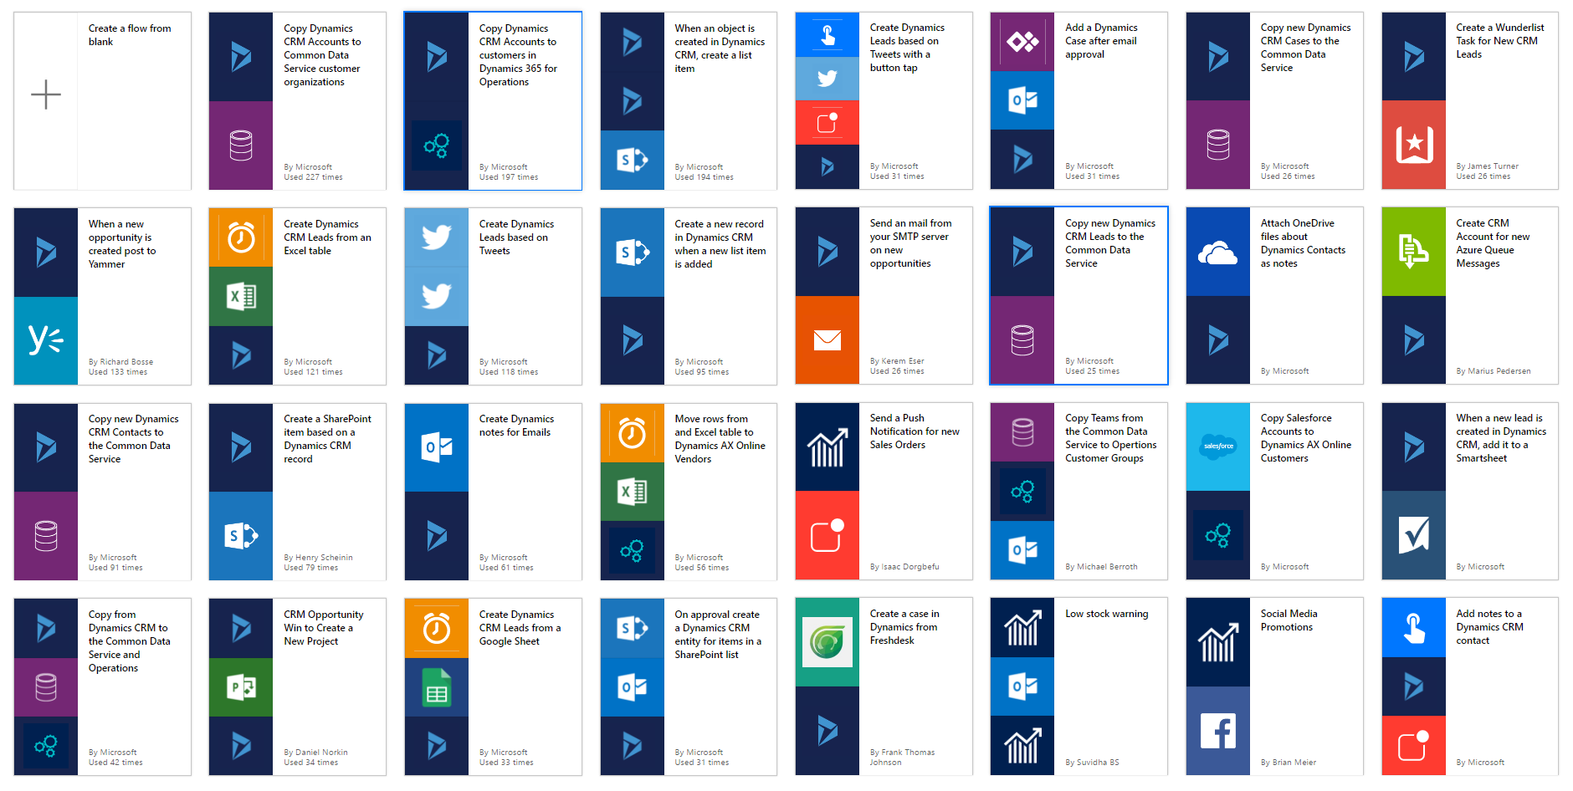
Get started quickly with hundreds useful templates
Notes:
User aver 100+ templates (and growing) for common scenarios as a starting point to create your new workflow!
Various use cases – many of which have been submitted by users like yourselves.

Slide 21
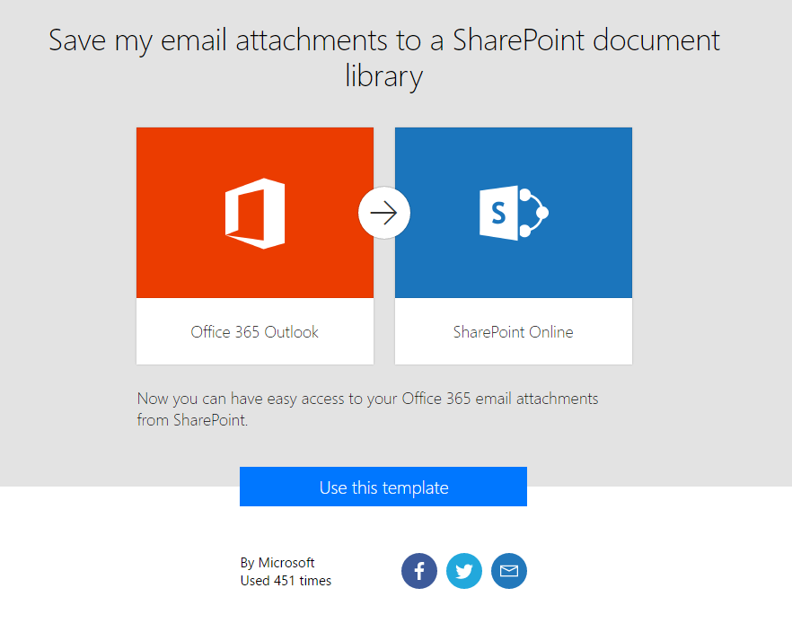
Simple explanation + landing page for templates
Detailed description of what the template does and needs
See how much this template has been used and who published it
Easily share templates via social media or email with your colleagues or friends
Notes:
Microsoft Flow is a SaaS service that helps business users work smarter by automating workflow across a growing number apps & services that they rely on.
The possible workflows span across a wide variety of possibilities, for example :
Get a notifications when a certain file is updated
Synchronize files by connecting your folders to keep data current,
Automatically collect and organize your business data
Streamline approvals and get instant alerts.
Microsoft Flow makes it possible to automate all of these scenarios and more.

Slide 22
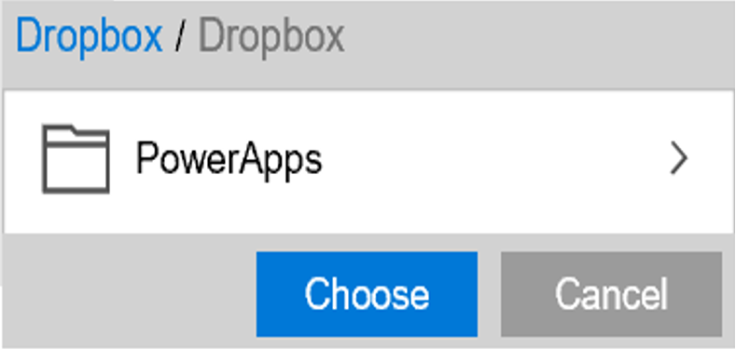
Build your own flow from scratch like a pro integration developer!
Sending an Exchange email when a new file is added in Dropbox
Authenticate to your Dropbox account.
Select folder to monitor
PowerApps
Choose to include properties from previous step (Dropbox file) to improve relevance
Authenticate to your O365 account. Build email Subject and Body
Specify Send To email address and additional properties (optional): From, CC, BCC and Importance
Connected to johnsharp@contoso.com
Notes:
In addition to utilizing Templates, end-users can easily build their own Flows or customize any of the available templates through an easy to use visual designer.

Slide 23
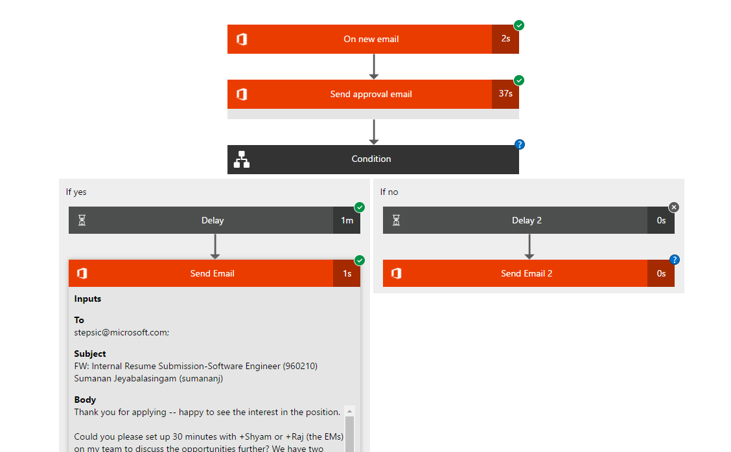
Debug (even real time visual debugging) any flow if needed… make changes and resubmit requests!
Save visual representation as building / creation time
See detailed inputs / outputs for each step

Slide 24
Consolidated list of all connectors in a single location to easily manage them
Same list of connections is shared between PowerApps and Flow so you only have to sign in once
If your password changes or you revoke the application access you can come here to sign-in again and fix it
Delete connections if you no longer want Flow and PowerApps to be able to access that data

Slide 25
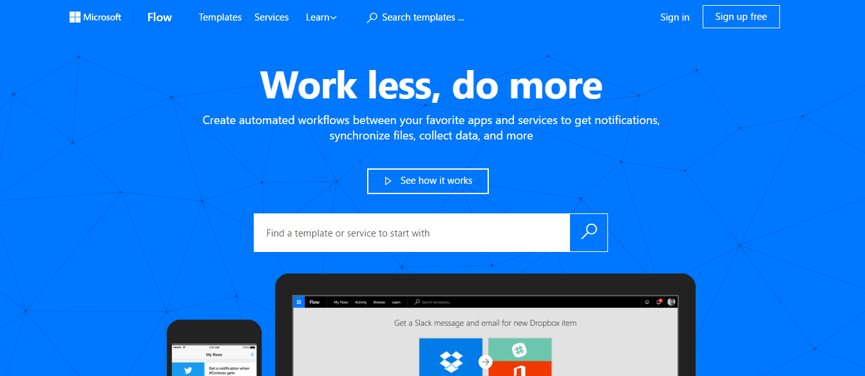
Flow web portal at https://flow.microsoft.com/en-us/
Learn how to use Flow (tutorials and videos) at https://flow.microsoft.com/en-us/guided-learning/
Integrated with Office365
Flow of the Week: https://flow.microsoft.com/en-us/blog/
Twitter
@MicrosoftFlow
@wearsy
Where you manage Flow and how can we get start?
Notes:
If you have access to Office 365 or Dynamics 365 then
You have entitlement to Microsoft Flow
https://flow.Microsoft.com
Feedback
https://aka.ms/flowpa_mvpsummit2018
Twitter
@MicrosoftFlow
@wearsy

Slide 26

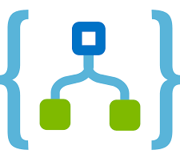
Under the hood, Flow is a Logic App… encapsulating some of its complexity and making it more appealing to Business Users
Any Flow can be converted to a Logic App!
Notes:
Can’t think of a single organisation that does NOT have a need for integration
Integration is a specialised skill
Some integration needs are very simple and/or very common

Slide 27
PowerApps & Flow ♥ …

Slide 28

Hands-on Lab PA + Flow
Hmmm, Donuts!
Create an empty app.
Add a button to call Flow.
Add a button to reset the Flow return variable.
Set (var; Blank())
Add the media to the app (Homers image. Menu -> Media -> Images)
Images visibility must be according to the Flow response variable being empty or not.
It’s not necessary to make conditional branching, just set the Visibility property to the result of the Blank command. It will return a boolean indication if the variable is empty or not.
Create a Flow that responds to the App with the text “Donuts”.
Create a textbox which will receive the Flow response.

Slide 29

Obrigado
http://aka.ms/2018GlobalOffice365DevBootcampSurvey
Notes:
[60s]

